Slide 1
Big Data – Introduction to Hadoop
Lecture 2

Slide 2
Big Data Challenges
Need to store lots of data – Move from single share storage to Distributed storage
Need faster processing – Move from Serial processing to Parallel processing
Need to deal with unstructured Data too

Slide 3
Hadoop
Hadoop is a framework for storing data on large clusters of commodity hardware - everyday hardware that is affordable and easily available - and running applications against that data
A cluster is a group of interconnected computers, known as nodes, that work together on the same problem
Using networks of affordable compute resources to acquire business insight is the what Hadoop is about

Slide 4
Hadoop is a solution to the Big Data problem
Hadoop is technology to store massive datasets on a cluster of cheap commodity machines in a distributed manner
It provides Big Data analytics through distributed computing framework
Hadoop is an open source software platform and used for processing large volume of data processing at massive scale. Handles unstructured data
Hadoop architecture has 2 core components: Storage known as Hadoop Distributed File System(HDFS) and Computing stuff using MapReduce(MR).

Slide 5
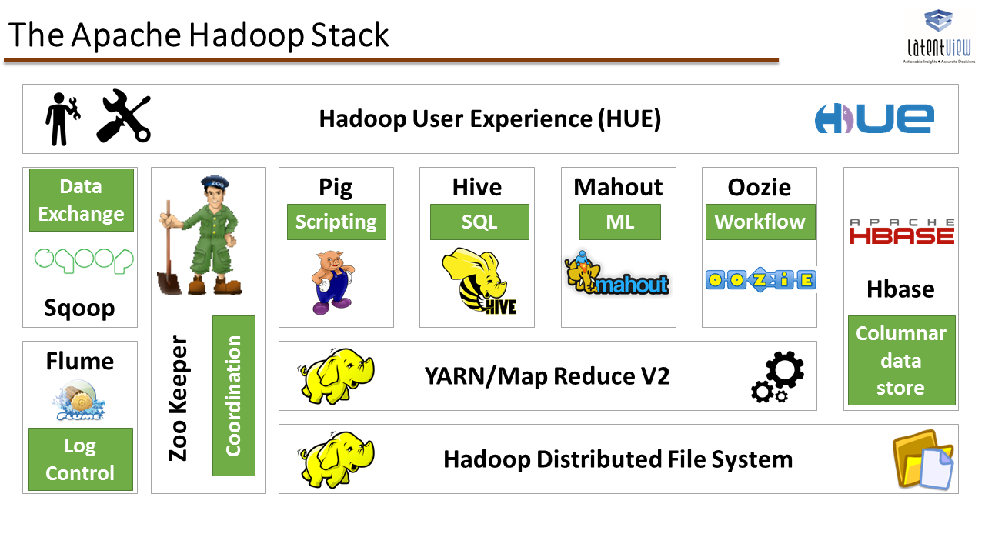
Hadoop Ecosystem

Slide 6
Hadoop ecosystem – Apache Hive
Open source system for querying and analysing large datasets stored in Hadoop (HDFS) files.
Hive has 3 main functions: Data summarisation, Query, and Analysis
Uses an SQL type language called HiveQL (HQL). HiveQL automatically translates SQL-like queries into MapReduce jobs (parrallel processing) which will execute on Hadoop
HQL is declarative language operates on the server
Developed by Facebook

Slide 7
Hadoop ecosystem - Apache Pig
Apache Pig is a high level procedural language platform for analysing and querying huge dataset that are stored in HDFS
Pig uses PigLatin language.
It operates on the client side
Developed by Yahoo
Instead of writing Java code to implement MapReduce you can chose either Pig Latin and Hive SQL languages to construct MapReduce programs.
Benefit of coding in Pig and Hive is that is much fewer lines of code and reduces the overall development and testing time

Slide 8
Hadoop ecosystem – Apache HBase
Hadoop perform batch processing and data is accessed sequentially. One has to search the entire dataset even for the simplest of jobs – v slow!
It provides random real time read/write access to data in HDFS
Is a distributed database that was designed to store billions of row and millions of columns.
HBase is scalable, distributed, and NoSQL database that is built on top of HDFS.
HBase provide real-time access to read or write data in HDFS
It’s origin from Google Bigtable

Slide 9
Hadoop Ecosystem
Apache Sqoop imports data from external sources into related Hadoop ecosystem. It also exports data from Hadoop to other external sources. Sqoop works with RDBMS like Oracle, MySQL
Apache Flume efficiently collects, aggregate and moves a large amount of data from its origin and sending it back to HDFS. It is fault tolerant and reliable mechanism. Used for streaming logs and event based

Slide 10
Hadoop Architecture
Hadoop Common: Are Java libraries and utilities required by other Hadoop modules. These libraries provides filesystem and OS level abstractions and contains the necessary Java files and scripts required to start Hadoop
Hadoop YARN: This is a framework for job scheduling and cluster resource management
Hadoop Distributed File System (HDFS): A distributed file system that provides high throughput access to application data
Hadoop MapReduce: This is YARN based system for parallel processing of large data sets

Slide 11
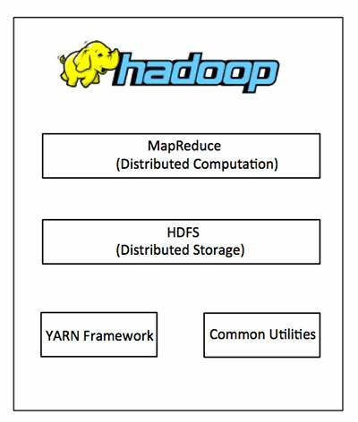
Hadoop Architecture

Slide 12
Hadoop - a reliable shared data storage and data analysis system
Hadoop consists of 2 main components:
a distributed file system - the Hadoop distributed file system (HDFS)
a distributed processing framework - MapReduce (supported by a component called YARN)
Application running on Hadoop gets its work divided among the nodes (machines) in the cluster and HDFS stores the data that will be processed
A Hadoop cluster can span 1000s of machines where HDFS stores data and MapReduce jobs do their processing near the data which reduces I/O

Slide 13
Responsible for storing Data in Blocks
Storage
HDFS
Hadoop
MapReduce/YARN
Compute
Responsible for Massive Parellel Processing

Slide 14
Hadoop
Hadoop cluster is a form of compute cluster used mainly for computational purposes. Consists of many computers (compute nodes) in a cluster and can share computational workloads & take advantage of a very large aggregate bandwidth across the cluster
Hadoop clusters typically consist of a few master nodes (NameNode) which control the storage and processing systems in Hadoop and many slave nodes (DataNodes) which store all the cluster data and is also where the data gets processed
Hadoop runs on a group of networked computers
In Hadoop terminology each computer is a node
The whole group is referred to as a cluster

Slide 15
Key to Hadoop’s Power
Process data in parallel across thousands of ‘commodity’ hardware nodes
Self- healing
Failure handled by software
Designed for one write, multiple reads
Optimised for minimum seek on hard drives
Cannot update data once written
Data and data processing tightly integrated
Designed to work together

Slide 16
What can Hadoop do?
Explore full datasets
Mine larger datasets
Too large for conventional memory based processing
Large scale data preparation
Cleaning, pre processing
Accelerate data driven innovation
RDBMS uses ‘schema on write’
ER diagrams, 3rd Normal form…
Hadoop uses ‘schema on read’
Dump the data on the HDFS (Data Lakes but not Data Swamps!)

Slide 17


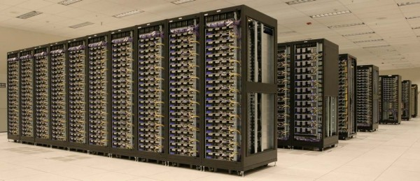
Explore Large Datasets Directly with Hadoop
Researcher laptop
R, Matlab, SAS, etc
Measure, Evaluate
Model
Measure/Evaluate
Clean Data
Visualize
Acquire
Model
Acquire
Full dataset stored on Hadoop
Visualize
Clean data

Slide 18
Hadoop Architecture comprises three major layers
They are:-
Data Storage: HDFS (Hadoop Distributed File System)
Resource management: Yarn
Compute: MapReduce

Slide 19
Why is Hadoop popular?
Apache Hadoop is a platform for data storage as well as processing. It is Scalable (add more nodes on the fly), Fault-tolerant (even if nodes crashes data processed by another node).
The following makes it a powerful platform:
Flexibility to store and mine any type of data whether it is unstructured, semi-structured or structured. It is not schema on write and not bounded by a single schema
Excels at processing complex data. Its horizontally scales-out and divides workloads across many nodes
Scales economically as it can deployed on commodity hardware. Also its open source nature guards against vendor lock

Slide 20
Hadoop Features
1. Reliability
If any node goes down it will not disable the whole cluster - another node will take the place of the failed node. Hadoop cluster will continue functioning as nothing has happened – it has built in fault tolerance feature
2. Scalable
Keep adding commodity servers to horizontally to scale up. If you are installing Hadoop on the cloud it is even simpler as you can easily procure more hardware and expand the Hadoop cluster within minutes
3. Economical
Hadoop gets deployed on commodity hardware which are cheap. Moreover Hadoop is an open system software there is no cost of license

Slide 21
Hadoop Features (Cont)
4. Distributed Processing
Any job submitted by the client gets divided into the number of subtasks and these subtasks are independent of each other. They execute in parallel giving high throughput.
5. Distributed Storage
Splits each file into the number of blocks. These blocks get distributed on the cluster of machines.
6. Fault Tolerance
Replicates every block of file many times depending on the replication factor (3 by default). If any node goes down then the data on that node gets recovered as this copy of the data would be available on other nodes due to replication

Slide 22
Hadoop Flavours
Apache – Vanilla flavour, as the actual code is residing in Apache repositories
Cloudera – It is the most popular in the industry.
Hortonworks – Popular distribution in the industry (Azure used it)
MapR – It has rewritten HDFS and its HDFS is faster as compared to others.
IBM – Proprietary distribution is known as Big Insights.

Slide 23
Examples 1 Hadoop usage: Log Analysis
Logs that record data about the web pages that people visit and in which order they visit them
Example: a typical web based browsing and buying experience:
You surf a website looking for an item to buy
You click to read descriptions of a product that you like
You add an item to your shopping cart and proceed to the checkout
After seeing the cost of shipping you decide that the item is not worth it and close the browser
Every click you have made and then stopped has the potential to offer valuable insight
Ecommerce businesses need to understand factors behind abandoned shopping carts. When you perform deeper analysis on the clickstream data patterns emerge

Slide 24
Log Analysis - Continued
Questions we may ask :
Are certain products abandoned more than others?
How much revenue can be recaptured if you decrease cart abandonment by 10 percent?
Hadoop has the ability to analysing log data as the data can be v large. Tools like Pig and Hive allow basic log analysis to be done
What would you do without Hadoop? Ignore such Log analysis probably!

Slide 25
Example 2 Hadoop usage: Risk Modeling
More data allows you to “connect the dots” and produce better risk prediction models
Hadoop allows data sets used in risk models to include underutilised or sources that were previously never utilised eg social media, email, instant messaging, etc, data sources.
Hadoop is ideal for Building and stress-testing risk models. These operations are often computationally intensive and impractical to run against a traditional Data Warehouse because:
The warehouse probably is not optimised for such queries issued by the risk model - Hadoop is not bound by the Data Models used in Data warehouses
A large ad hoc batch job such as risk model would increase the load on the warehouse degrading its performance - Hadoop can assume this workload and freeing up the warehouse for it regular reports
Advanced risk models likely to need unstructured data as input and Hadoop can handle that

Slide 26
Hadoop is a powerful tool (but not a solution)
Hadoop is not the complete solution. Although risk management leverage the strengths of Hadoop, Hadoop by itself does not solve these issues
Deveopers need to write code with an understanding of the problem so that they utilise Hadoop strength to solve the business problem.
For example, it does not help in picking up unusual patterns – it just allows large data to be processed concurrently

Slide 27
What Hadoop can do
The differentiator that Hadoop brings is that now you can do the same things you could do with a traditional Database but on a much larger scale and get better results.
It allows you to manage petabytes of data which is unheard of in the database world previously

Slide 28
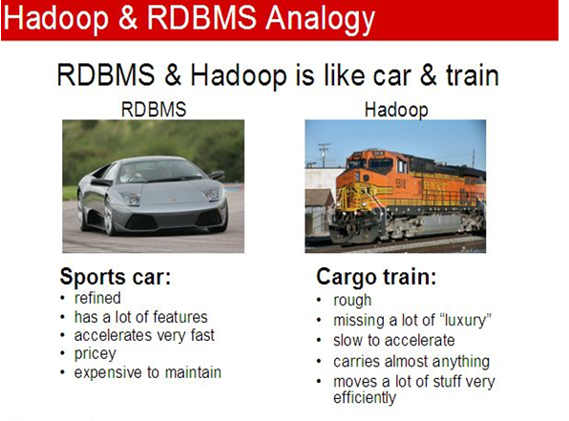
From Macy’s

Slide 29
Class work 1
In the analogy in the previous slide, what else would you add/change for RDBMS?
What would you change for Hadoop?

Slide 30
Hadoop Distributed Filesystem (HDFS) Scale out well
Large HDFS deployments run on many tens of thousands of machines with storage capacity of many hundreds of Petabytes
Viable because of cost of data storage and access on HDFS using commodity hardware and open source software
The emphasis is on high throughput of data access rather than low latency of data access
Latency is time require to perform an action & measured in unit of time eg seconds
Throughput is no of such actions executed per unit time

Slide 31
HDFS Architecture
HDFS has one NameNode and series of DataNodes. Application data is stored on DataNodes and file system metadata is stored on NameNode.
HDFS replicates the file content on multiple Data Nodes based on the replication factor to ensure reliability of data.
Hadoop brings power of distributed data processing where data is stored. It allows massive parallel processing in a distributed manner

Slide 32
HDFS – Distributed file system in more detail
HDFS provides a distributed architecture for extremely large scale storage and can easily be extended by scaling out as opposed to scale up
Compared to storing files on your PC, files in Hadoop is designed to work optimally with a small number of very large files like 500MB
HDFS has a Write Once, Read Often model of data access. That means the contents of individual files cannot be modified – you can append new data to the end of the file.
HDFS uses sequential access pattern – access data in sequence thereby seek once (unlike random access)

Slide 33
HDFS –write once read often
HDFS files you can do:
Create a new file
Append content to the end of a file
Delete a file
Rename a file
Modify file attributes like owner

Slide 34
Hadoop Distributed File System (HFDS)
Designed for large-scale data processing
Allows storage of large data files > 100 TB in one file
Runs on top of native file system on each node (Linux or Windows)
Data is stored in units known as blocks
128MB (default) can be larger
Large datasets are stored in many blocks over many nodes
Enables dataset to be bigger than individual disks in Hadoop cluster
Blocks are replicated to multiple nodes
Allows for node failure without loss of data

Slide 35

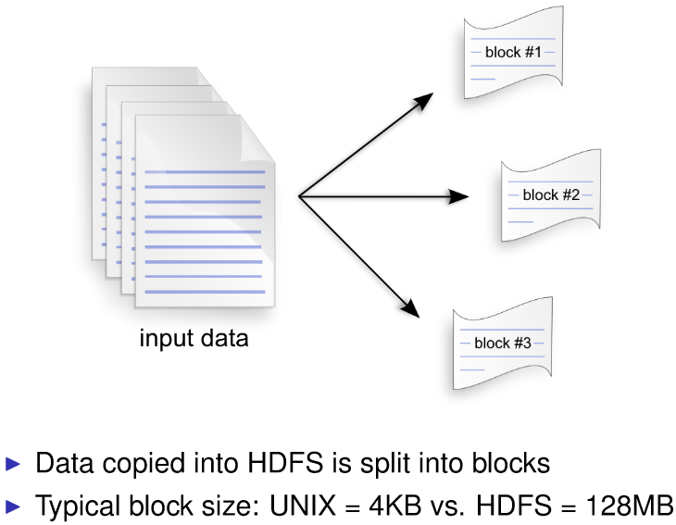
HDFS default block size 128MB

Slide 36
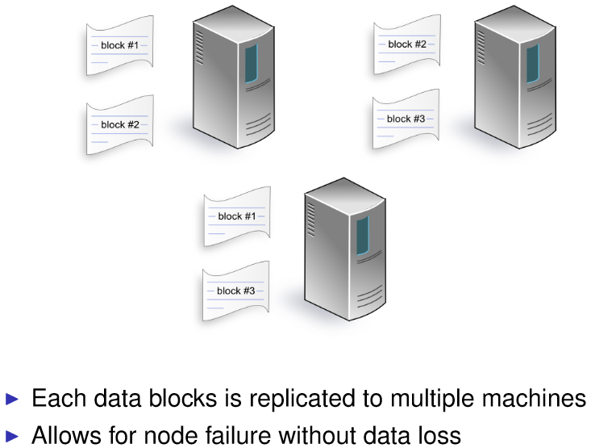

Slide 37
HDFS – has a Master/Slave Architecture
HDFS uses a master/slave architecture where master consists of a single NameNode that manages the file system metadata and one or more slave DataNodes that store the actual data.
A file in an HDFS namespace is split into several blocks and those blocks are stored in a set of DataNodes. The NameNode determines the mapping of blocks to the DataNodes.
The DataNodes takes care of read and write operation with the file system. DataNodes manage the storage that associated with the nodes on which they run, serving client read and write requests. They also take care of block creation, deletion and replication based on instruction given by NameNode.

Slide 38
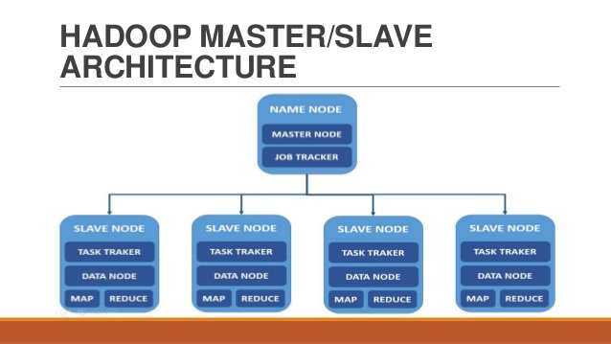

Slide 39
HDFS
When you store a file in HDFS, the system breaks it down into a set of individual blocks and stores these blocks in various DataNodes (slave nodes) in the Hadoop cluster
HDFS does not know what is stored inside the file, so raw files are not split in accordance with rules that we humans would understand
The concept of storing a file as a collection of blocks is entirely consistent with how file systems normally work but not the scale.
A typical block size in a file system under Linux is 4KB, whereas a typical block size in Hadoop is 128MB (in Hadoop 2.X) - value is configurable & can be customised

Slide 40
HDFS Large Block Size – why?
Hadoop was designed to store data at the petabyte scale with no scale out bottlenecks
The high block size helps to store big data because:
Each data block stored in HDFS has its own metadata and needs to be tracked by a central server so that applications needing to access a specific file can be directed to wherever all the file’s blocks are stored. If block size were in the KB range, even modest volumes of data in the terabytes would be too much for metadata server with too many blocks to track.
HDFS is designed to enable high throughput so that the parallel processing of these large data happens. Having too large a block size (10s GB) may make parallel processing slow and inefficient.
With less blocks, the file will be stored on less nodes and this reduces degree of parallel processing

Slide 41
HDFS – Replicating data blocks
HDFS assumes that every disk drive and every slave node is unreliable
Care must be taken in choosing where the three copies of the data blocks are stored
Data blocks are striped across the Hadoop cluster - they are evenly distributed between the Datanodes (slave node) so a copy of the block will still be available regardless of disk, node, or rack failures

Slide 42
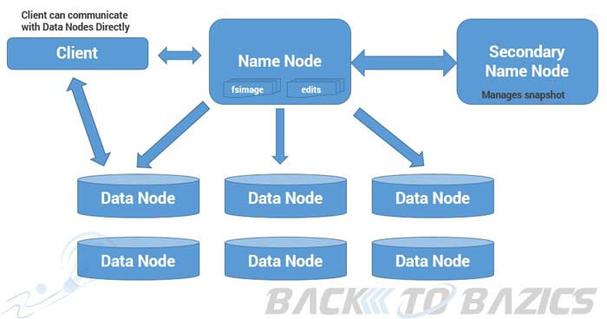
Hadoop Master-Slave Architecture

Slide 43
HDFS
NameNode (or Master) is a high end machine where as DataNode (Slaves) are inexpensive computers
The Big Data files get divided into the number of blocks. Hadoop stores these blocks in a distributed fashion on the cluster of Datanode (slave nodes).
On the NameNode (master), we have metadata stored.

Slide 44
HDFS has 2 daemon process running:
NameNode : NameNode performs following functions:
NameNode Daemon runs on the master machine.
It is responsible for maintaining, monitoring and managing DataNodes
Records the metadata of the files like the location of blocks, file size, permission, hierarchy etc.
Namenode captures all the changes to the metadata like deletion, creation and renaming of the file in edit logs.
It regularly receives heartbeat and block reports from the DataNodes.

Slide 45
HDFS Daemon processes
DataNode: The various functions of DataNode are as follows:
DataNode runs on the slave machine.
It stores the actual data
It serves the read/write request from the user
DataNode does the ground work of creating, replicating and deleting the blocks on the command of NameNode.
After every 3 seconds it sends heartbeat to NameNode reporting the health of HDFS

Slide 46
Disk failures are inevitable
If disk fails the cluster continues functioning but performance degrades because processing resources is lost. The system is still online & all data is still available.
If disk fails, the Namenode (the central metadata server for HDFS) finds out the file blocks stored on it and thereby detects block is under –replicated and it creates new copy the failed block
When the failed disk comes back online HDFS ensures there are three copies of all the file blocks. But now there is 4 copies and it is over replicated - As with under-replicated blocks the namenode will detect this and will order one copy of every file to be deleted

Slide 47
HDFS is based on share nothing principle
Unlike shared disk approach eg Network Attached Storage (NAS) and Storage Area Network (SAN) architectures
Shared Disk storage implemented by centralised storage application with custom hardware and special network infrastructure
Shared nothing approach does not require any special hardware (expensive) but only commodity computers connected by a conventional datacentre network

Slide 48
A basic Analogy for parallel processing
Suppose you have to build one house. One person is working on it and is expecting to be completed in a year
If we will introduce 12 people to do that job, it will be constructed faster. Can they complete in a month or 2?
They will work parallel and the task will get completed faster
Hadoop gives the ability to perform distributed storage and distributed processing of very large data sets on computer clusters built from commodity hardware

Slide 49
What is MapReduce?
Built on the concept of divide and conquer by using distributed computing and parallel processing
Faster to break massive tasks into smaller chunks, allocate them to multiple servers and process them in parallel
Programming logic is placed as close to the data as possible. This technique works with both structured and unstructured data
With Distributed file system (HDFS) the files are already divided into bite sized pieces. MapReduce is what you use to process all the pieces.

Slide 50
MapReduce overview
In the Map phase of MapReduce, records from a large data source are divided up and processed across as many servers as possible in parallel to produce intermediate values
After Map processing is completed the intermediate results are collected and combined or reduced into final value

Slide 51
MapReduce advantages
Parallel Processing: By dividing the job among multiple nodes and each node works with a part of the job simultaneously and therefore time taken to process data gets reduced significantly
Data Locality: Instead of moving data to the processing unit, we move the processing unit to the data
In the traditional system, we used to bring data to the processing unit and process it. As data grew and became very huge, bringing this huge amount of data to the processing unit gave the following issues:
Moving huge data to processing is costly and deteriorates the network performance.
Processing takes time as the data is processed by a single unit which becomes the bottleneck.

Slide 52
Map Reduce
MapReduce processes a sequence of operations on distributed data sets. The data consists of key-value pairs, and the computations have only two phases: a map phase and a reduce phase. User-defined MapReduce jobs run on the compute nodes in the cluster.
Map Reduce consists of:
1 During the Map phase, input data is split into a large number of fragments, each of which is assigned to a map task.
2 These map tasks are distributed across the cluster.
3 Each map task processes the key-value pairs from its assigned fragment and produces a set of intermediate key-value pairs.
4 The intermediate data set is sorted by key, and the sorted data is partitioned into a number of fragments that matches the number of reduce tasks.
5 During the Reduce phase, each reduce task processes the data fragment that was assigned to it and produces an output key-value pair.
6 These reduce tasks are also distributed across the cluster and write their output to HDFS when finished.

Slide 53
YARN (short for Yet Another Resource Manager)
YARN provides generic scheduling and resource management services so that you can run more than just Map Reduce applications on your Hadoop cluster. The JobTracker/TaskTracker architecture could only run MapReduce.

Slide 54
Class Work 2
What are the advantages of Hadoop?
What are the Disadvantages of Hadoop?

Slide 55
Advantages of Hadoop
Varied Data Sources
Supports variety of un/structured data eg email, social media etc. It can accept data in a text file, XML file, images, CSV files etc.
Cost effective
Uses commodity hardware to store data and this is cheap
Performance
With its distributed processing & storage architecture it processes huge amounts of data with high throughput. It divides input data file into a number of blocks and stores data in these blocks over several nodes. It also divides task that user submits into various sub-tasks and executes them in parallel

Slide 56
Advantages of Hadoop (Cont
Highly Available
In Hadoop 2.x, HDFS architecture has a single active NameNode and a single Standby NameNode so if a NameNode goes down then we have standby NameNode to count on. But Hadoop 3.0 supports multiple standby NameNode making the system even more highly available as it can continue working if two or more NameNodes crash
Low Network Traffic
Each job submitted by the user is split into a number of independent sub-tasks and these sub-tasks are assigned to the data nodes thereby moving a small amount of code to data rather than moving huge data to code which leads to low network traffic
High Throughput
Throughput means job done per unit time. A given job gets divided into small jobs which work on chunks of data in parallel thereby giving high throughput.

Slide 57
Hadoop Advantages (cont)
Open Source
Hadoop is open source technology i.e. its source code is freely available.
Scalable
Hadoop works on the principle of horizontal scalability scale out rather than scale up
Fault Tolerant
In Hadoop 3.0 fault tolerance provided by erasure coding. For example, 6 data blocks produce 3 parity blocks by using erasure coding technique, so HDFS stores a total of these 9 blocks. In event of failure of any node the data block affected can be recovered by using these parity blocks and the remaining data blocks
Emerging technology of Big Data are compatible with Hadoop like Spark, Flink. They have got processing engines which work over Hadoop as a backend - Hadoop is the data storage platforms for them.

Slide 58
Disadvantage of Hadoop
Hadoop is not good with Small Files
Hadoop is suitable for a small number of large files but not with a large number of small files. A small file is nothing but a file which is significantly smaller than Hadoop’s block size (128MB). These large number of small files overload the Namenode as it stores namespace for the system and makes it difficult for Hadoop to function.
Processing Overhead
Data is read from the disk and written to the disk which makes read/write operations very expensive when with Big Data (eg petabytes of data). Hadoop cannot do in memory calculations and incurs processing overhead

Slide 59
Disadvantage of Hadoop
Hadoop supports only Batch Processing
Hadoop is a batch processing system which is inefficient for stream processing and realtime requirements with low latency. It only works on data which we collect and store in a file in advance before processing.
Security
For security , Hadoop uses Kerberos authentication which is hard to manage and does not have encryption at storage and network levels
Vulnerable
Hadoop is written in Java and it can be exploited by cyber criminals which makes it vulnerable to security breaches.

Slide 60
Installing Hadoop on your PC
Hadoop is designed to be deployed on a large cluster of networked computers with master nodes and slave nodes. However, you can run Hadoop on a single computer to help to learn the basics of Hadoop
Hadoop has two deployment modes: pseudo-distributed mode and fully distributed mode
To download on your PC: https://www.cloudera.com/downloads/quickstart_vms/5-13.html
Useful tips: https://community.cloudera.com/t5/Community-Articles/How-to-setup-Cloudera-Quickstart-Virtual-Machine/ta-p/35056

Slide 61
Installing Hadoop On Your Personal Machine
These instructions use the Cloudera QuickStart VM which runs inside the VirtualBox virtual environment, which needs to be installed first.
• Download and install VirtualBox on your machine: https://www.virtualbox.org/wiki/Downloads
• Download the Cloudera Quickstart VM (it is free but you have to register). Select VirtualBox as the platform https://www.cloudera.com/downloads/quickstart_vms/5-12.html
• Uncompress the VM archive (7-Zip is recommended)
• Start VirtualBox and click Import Appliance in the File dropdown menu. Click the folder icon beside the location field. Browse to the uncompressed archive folder, select the .ovf file, and click the Open button. Click the Continue button. Click the Import button.
• Your virtual machine should now appear in the left column. Select it and click on Start to launch it.
• To verify that the VM is running and you can access it, open a browser to the URL: http://localhost:8088. You should see the resource manager UI. The VM uses port forwarding for the common Hadoop ports, so when the VM is running, those ports on localhost will redirect to the VM.
The Cloudera QuickStart VM is a single-node cluster making it easy to quickly get hands on experience with Hadoop, Hive and Pig.
Note that the Cloudera Quickstart VM archive is a large file in excess of 5GB so it might make sense to download it overnight (you might need to disable your computers sleep function).

Slide 62
Video
https://www.youtube.com/watch?v=DCaiZq3aBSc&t=582s

